Slide 1

TEAM ADASTRA · MASUMI TRACK
ANTIDOTE
Antivirus protects computers. Nobody protects what machines believe.
Epistemic recalls for agent fleets.

Slide 2
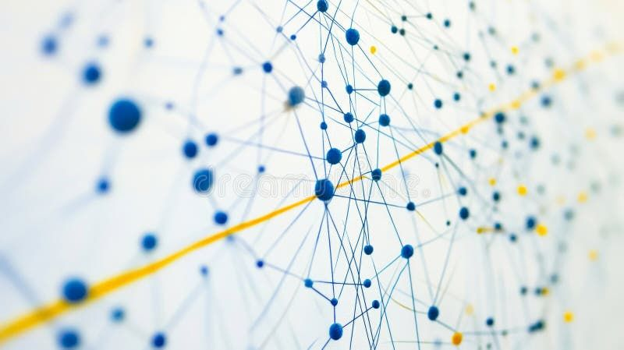
Epidemic Contamination
Agents don't just answer — they ingest and act.
>
One forged source becomes a belief.
>
That belief drives autonomous outputs.
>
Downstream agents ingest those outputs.
>
A fake PDF metastasizes in minutes.
A trader sizes a multi-million-dollar position and all on a lie, all automatically.

Slide 3


The Missing Infrastructure
Food, cars, drugs have recalls. Information has nothing.
Provenance
ANTIDOTE
THE STANDARD APPROACH
THE MISSING LAYER
"Where did it come from?"
"Claw it back from every mind."
Provenance is prevention at the door. It fails once the bad batch ships.
We answer the unsolved inverse. Pull poison from every agent that ingested it.

Slide 4

Public Health for Machines
Public Health | ANTIDOTE Mechanism
Diagnostics | Detector scores incoming sources for forgery signals
Outbreak declaration | Staked recall, slashable if false
Contact tracing | Contagion graph over gateway-written manifests
Quarantine | On-chain gate + Masumi refuses the hire
Treatment | Paid decontamination agent
Immunisation | Antibodies refuse the same lie, even reworded

Slide 5






An Immune System For Money
Every recall creates paid work. Monetization is the immune system.
Paid Cleanup
Quarantine
Doubt Market
Decontamination costs 25 ADA. Auditing costs 15 ADA. Agents heal agents, for money.
Enforced strictly on the Masumi rails. A flagged agent cannot earn or transact.
Being early to a lie is a revenue stream. Stake pays out over Masumi.

Slide 6
The Recall Lifecycle
Ingest: Through a gateway → content-addressed shards + Merkle manifest.
Detect: Forgery signals trigger an advisory flag.
Recall: Staked alarm; slashable if proven false.
Trace: Resolve exposure direct & transitive via manifests.
Quarantine: On-chain gate + Masumi both refuse operations.
Heal: Paid purge → staked audit → cleared → immunised.

Slide 7
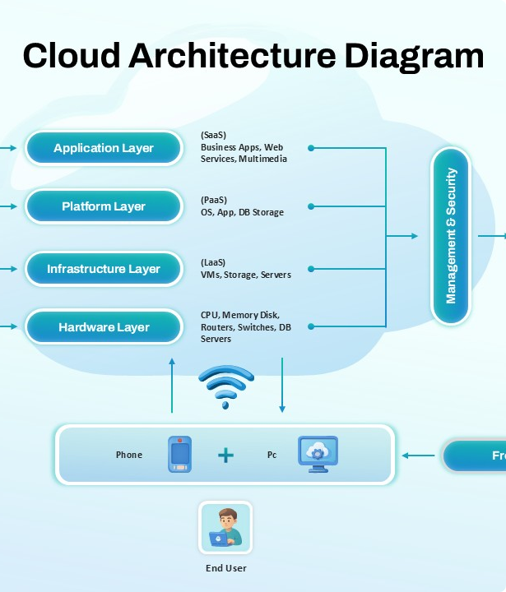
Architecture
END-TO-END TYPESCRIPT
Registry (Hono)
Gateway, detector, recalls, contagion graph, paid hiring.
Agents (5 × MIP-003)
Research · Analysis · Trading · Decontam · Auditor
Contracts
3 Aiken Plutus V3 validators with 14 passing tests.
Budget: $0
Free tiers only. LLM failover. Strict zero-dollar operations.

Slide 8

THE CENTERPIECE
Live Demo
17 Beats.
~90 Seconds.
One Click.
▪
Forged report injected.
▪
Lie spreads → trader buys millions.
▪
Recall issued → fleet quarantined.
▪
Gate rejects the spend.
▪
Paid cleanup purges the poison.
▪
Same lie returns reworded → Fleet is immune.

Slide 9


Built. Tested. Real.
5
82
MIP-003 Agents
Automated Tests
Hired & paid seamlessly via Masumi.
68 unit + 14 on-chain tests. Full e2e autopilot.
* Real validators + script hashes. Gate evaluated in simulated mode; live tx submission = roadmap.

Slide 10


Beyond Recall (The Moat)
Immunisation & Autopsy
Doubt Market & Canaries
>
Antibodies: Fingerprint numeric claims. Refuse the same lie on contact, even if heavily reworded.
>
Doubt Market: Being early to spot a lie becomes a monetized position via Masumi.
>
Epistemic Autopsy: Replay decisions without the poison to measure the exact causal damage in dollars.
>
Sentinel Canaries: Invisible watermarks catch data an agent ingested but never declared reading.

Slide 11
Honest Limitations
Owning the edges makes the architecture credible.
Manifest honesty: We make dishonesty detectable via canaries, not impossible.
Unlearning scope: Strictly scoped to RAG/memory stores where deletion is provable.
Antibodies: Currently fingerprint numerical claims, not semantic meaning (next step).
Live tx submission: Validators are tested, but live submission is the final roadmap step.

Slide 12




Technical Roadmap
Live Tx
Slashing Game
Live Preprod transaction submission end-to-end.
Full automated dispute game for false recalls.
ZK Proofs
Semantic Immunity
Decontamination proof over same Merkle root (Midnight).
Embedding-based antibodies (meaning, not just numbers).

Slide 13

TEAM ADASTRA
ANTIDOTE
Antivirus protects computers. We protect what machines believe.

